Slide 1
Cyclistic
Members Behavior
Insight and recomendation to convert casual riders into annual members
Presented by: Fernanda Alfian
Last Updated: March 7

Slide 2
Table of Content
Objective
Insight from our data
Conclusions
Recommendations

Slide 3
What are we talking about?

Slide 4
Objective
Identify the customers behavior, number of riders, average ride duration from casual riders and annual members and give some recommendations to convert casual riders into annual membership.

Slide 5
Insight from the data

Slide 6
The questions that will guide us for this analysis
1. How do annual members and casual riders use Cyclistic bikes diﬀerently?
2. Why would casual riders buy Cyclistic annual memberships?

Slide 7
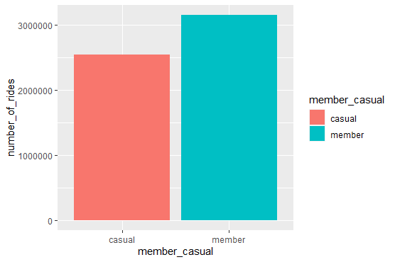
Number of rides
by member type
The number of annual member are higher than the casual riders.
There are 3.149.602 or 55.31% riders of annual members.
There are 2.543.902 or 44.68% riders of casual members.

Slide 8
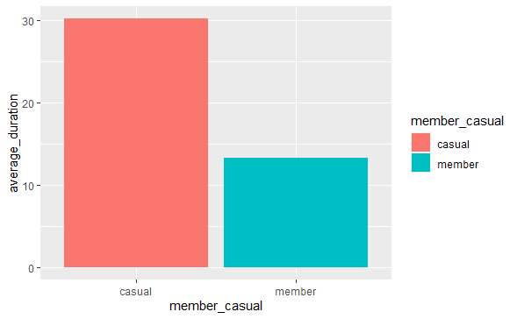
Average duration of rides
by member type
Average duration for casual riders are longer than annual member.
Casual member on average ride 30,18 minutes per ride.
Annual member on average ride 13,30 minutes per ride.
Note: I assume that casual riders rent the bike to cycle around for quite a long distance.
but for annual members cycle for short distance, example to commute to work each day.

Slide 9
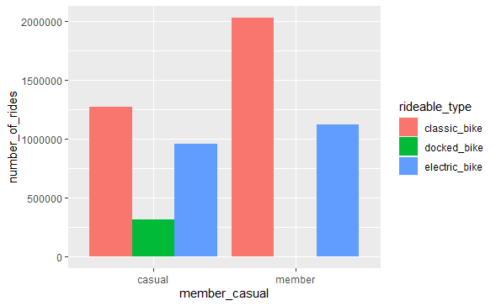
Number of rides from bike type
by member type
Classic bike is the most used bicycles in Cyclistic.
Followed by electric bike and docked bike

Slide 10
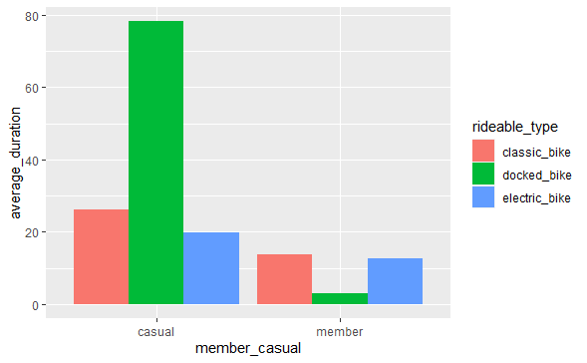
Average duration of rides
from bike type by member type
Docked bike from casual riders is the longest ride, more than 75 minutes minute on average.
Casual riders are still a longer duration than annual members.

Slide 11
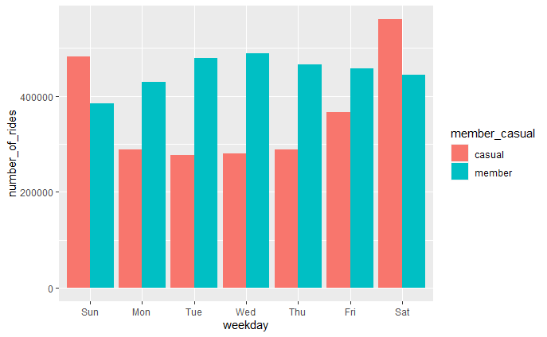
Number of rides per day of week
by member type
The number of casual riders are lesser than the number of annual members on the weekdays, and otherwise the weekends.
This indicate us that there is a difference behavior between annual members and casual riders.

Slide 12
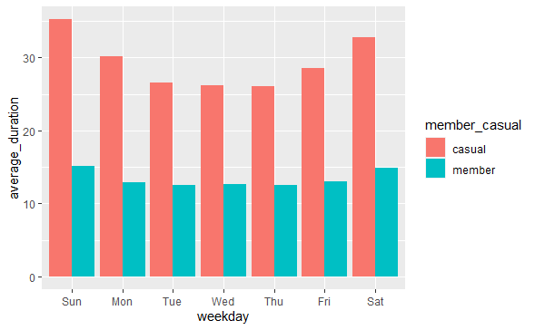
Average duration of rides
per day of week by member type
Casual riders have an average trip of around 26 to 29 minutes on weekdays, and higher on weekends of about 32 minutes to 35 minutes.
Otherwise, Annual members have an average trip of around 12 to 13 minutes on weekdays, and 14 to 15 minutes on weekends.
Note: I assume that even on weekdays casual riders who commute by bike have longer distances than annual members.
But this assumption needs to be confirmed from a distance in miles or km, but we have limited data to explore it

Slide 13
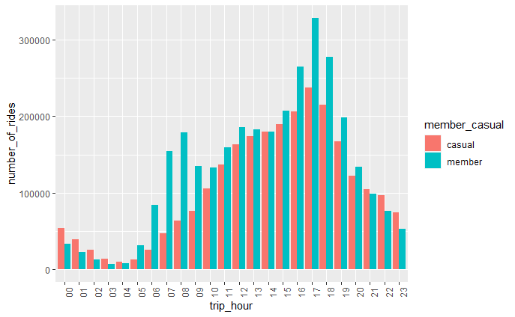
Number of rides per trip hour
by member type
Both casual riders and annual members mostly ride bicycles at evening from 4 pm - 6 pm
But the number decreases as the time approaches 4 am
During the peak hour morning 6 - 8 am, there is an increase in users for annual members.

Slide 14
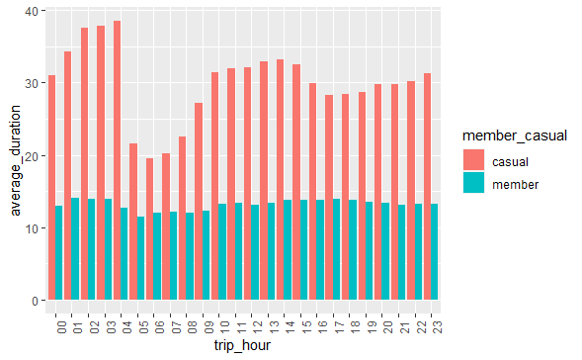
Average duration of rides
per trip hour by member type
Almost the same results from the previous bar chart.
The average duration of casual riders are higher than annual members.
Annual members get almost the same average duration around 11 - 14 minutes per one ride and per hour.
Otherwise, casual riders have a duration that varies from 19 to 37 minutes per one ride and per hour.
Note: This difference in behavior may indicate that casual riders have a longer duration, due to longer trips compared to annual members

Slide 15
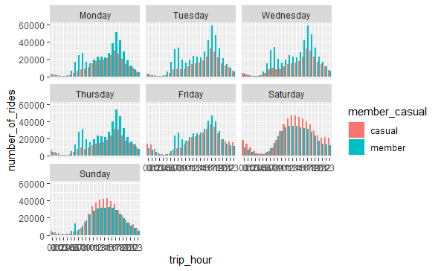
Number of rides per trip hour
by member type (per day of week)
The trend is almost the same as the number of rides as what we saw previously.
For the weekdays, the number of riders getting higher on morning peak hour and evening peak hours.
There are more annual members who rent the bicycle to commute to work on weekdays.
Casual riders also use bicycles to commute to work on weekdays.

Slide 16
Number of rides per trip hour
by member type (per day of week)
Behavioral differences can be seen on weekends or weekdays.
On weekend there are more casual riders who rent the bicycle to tour around (assumption).
Even though it looks like the number of them (casual riders and annual members) on weekends is not as much as weekdays.

Slide 17
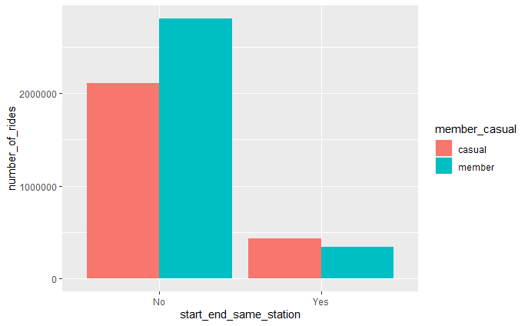
Number of rides who return the bike on same station
by member type
That there are only a few riders who will return the bike on the same station where they rented the bike.
It is mean that the riders usually will ride the bicycle to another place and return the bicycle there.

Slide 18
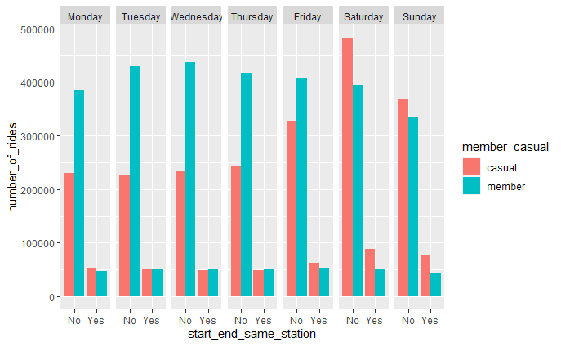
Average duration of rides who return the bike on same station from bike type by member type
The annual members who need to commute to work on weekdays will usually rent bicycle to cycle to the workplace and return bicycle at the station nearby the workplace.
While for weekends, the number of casual riders and annual members who rent bicycle are almost the same for returning bicycle at different station.

Slide 19
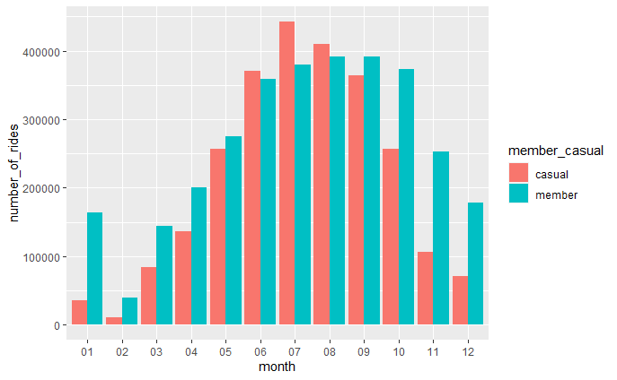
Number of rides from bike type
by member type
The number of riders starts to increase after winter, or increases from February and reaches the highest number in June and
When winter approaches, there are decrease in riders

Slide 20
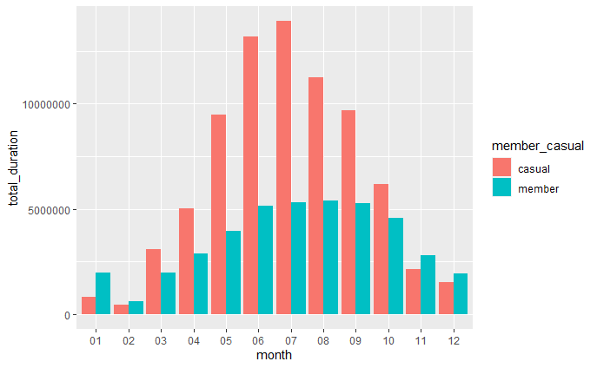
Average duration of rides
from bike type by member type
This chart shows the behavior of riders when faced with several seasons.
Especially in winter, people may not use bicycles and will use other transportation.
And still consistent on the previous charts, that casual riders still have a higher total duration compared to annual members

Slide 21
Annual members behavior
There are more annual members on weekdays.
Shorted duration per ride on average,
12 to 13 minutes on average on weekdays, and
14 to 15 minutes on average on weekends.
Annual members rent the bicycle to commute to work on weekdays.
And on weekends, they also use bikes to tour round city, but they are more casual riders on weekends.

Slide 22
Casual riders behavior
There are more casual riders on weekends.
Longer duration per ride on average,
26 to 29 minutes on average on weekdays, and
32 to 35 minutes on average on weekends.
Casual riders usually rent the bicycle both to commute on weekdays and to tour round city on weekends.
But on weekdays, they are more annual members than casual

Slide 23
Another insight behavior
Weather differences affect riders | Rent to commute / cyclist?
When winter approaches, there are decrease in riders The number of riders starts to increase after winter, or increases from February and reaches the highest number in June. | There are only a few riders who will return the bike on the same station where they rented the bike. It is mean that the riders usually will ride the bicycle to commute to another place. They need another bike to return the bicycle on the same station where they rented first time.

Slide 24
Member pass Cyclistics Analysis
Annual Member
Casual Riders
Day Pass
Single Ride
The Annual Membership is the best deal for locals and frequent riders. It’s designed for quick trips. Commute to work or school, run errands, get to appointments, and more. Just on Chicago and Evanston. Can take as many rides as you want throughout the year, and the first 45 minutes of each ride are included in your plan. | The Day Pass is perfect for visitors. Explore Chicago like never before – on two wheels! More flexibility – you don't have to return it to where you started, and you don't have to worry about finding a safe place to lock it up. The Day Pass costs $15 and includes unlimited classic bike rides in a 24-hour period, up to 3 hours each. | The Single Ride is a great option for spontaneous one-way trips or trying Divvy for the first time! Ride to anywhere. The Single Ride is just $3.30 and includes 30 minutes of ride time.

Slide 25
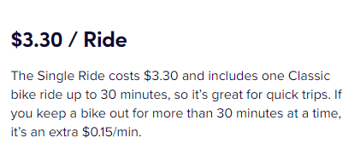
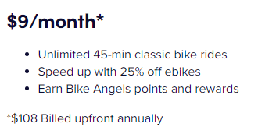
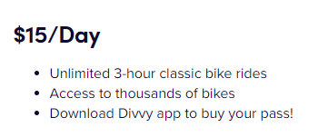
Member pass Cyclistics Analysis
Annual Member
Casual Riders
Day Pass
Single Ride
Taking a longer ride? If you keep a bike out for more than 45 minutes at a time, it’s an extra $0.15/min. | Want to take a ride longer than 3 hours? You can either check your bike in and check another bike out to avoid usage fees, or it's just an extra $0.15 per minute to keep the same bike out for longer than 3 hours. | Need to ride longer? If you keep a bike out for more than 30 minutes, it's an extra $0.15/minute.

Slide 26
Is the casual riders under the annual member duration limit?
I assume that riders usually ride to commute, their home – to work, museum, restaurant, etc – return to home. With another bike. Not to cycling, their home – cycling – return to home. With same the bike.
If they rent to commute, need at least 2 times to rent a bicycle to return to their home.
Average duration | Total durations (2 times rides) | Conclusions
Casual riders need 26 to 29 minutes per ride on weekdays 32 to 35 minutes per ride on weekends Annual members need 12 to 13 minutes per ride on weekdays 14 to 15 minutes per ride on weekdays | Casual riders need 52 to 58 minutes total in weekdays 64 to 70 minutes total in weekdays Annual members need 24 to 26 minutes total on weekdays 28 to 30 minutes total on weekends | Above the limit of 45 minutes per day. Below the limit of 45 minutes per day.

Slide 27
Conclusions

Slide 28
Conclusions
Different behavior | Member pass
Casual riders have longer average duration trips, rather than annual member. Both rent the bicycle to commute to work on weekdays, and to tour around city on weekends. But there are more annual members on weekdays, and otherwise on weekends, there are more casual members on weekends. | The limit of the annual membership is below the average trip duration for casual riders*. This can cause casual riders not to want to subscribe to the annual membership *with assumption that they need at least 2 times to rent a bicycle to return to their home.

Slide 29
Recommendations
How to convert casual riders into annual membership?

Slide 30
How to convert the casual riders to annual members?
Problems
Solutions
Goals
First purchase
App Install
Subscription Sign Up
Lead Submitted
Application
1st Repeat Purchase
1st Paid Action
Upgrade Subscription
Lead Closed
Approval
Long term spend
&
Churn
Casual riders have longer duration, between 52 to 70 minutes per day on its second trips.
Limit minutes per day on annual membership only 45 minutes per ride per day.

Slide 31
How to convert the casual riders to annual members?
Problems
Solutions
Goals
Long term spend
&
Churn
Casual riders have longer duration, between 52 to 70 minutes per day on its second trips.
Limit minutes per day on annual membership only 45 minutes per ride per day.
Cyclists can increase their annual membership trip limit per day to 60 minutes.
So casual riders can join the annual membership.

Slide 32
How to convert the casual riders to annual members?
Problems
Solutions
Goals
Casual riders have longer duration, between 52 to 70 minutes per day on its second trips.
Limit minutes per day on annual membership only 45 minutes per ride per day.
Cyclists can increase their annual membership trip limit per day to 60 minutes.
So casual riders can join the annual membership.
Increase the number of annual memberships from casual riders

Slide 33
THANK YOU!

Slide 34
Conclusions
Rent to commute to work (weekdays) | Rent to tour around city (weekends)
Both on casual riders and annual members also rent the bicycle to commute to work. There are more annual members on weekdays. Casual riders have a longer duration (26 to 29 minutes) rather than annual members (12 to 13 minutes) on average. | Both on casual riders and annual members also rent the bicycle to tour around city. There are more casual riders on weekends, but the difference is not as much as weekdays. Casual riders still have a longer duration (32 to 35 minutes) rather than annual members (14 to 15 minutes) on average.
Notes:
call out here is FS. Bc often if LTV isn't actionable it's bc what we need is FS!
The stats and machine learning are built in!
if LTV isn't actionable, it's usually bc what they actually need is feature selection
Will comment that we do not own these models

Slide 35
Conclusions
Weather differences affect riders | Rent to commute / cyclist?
When winter approaches, there are decrease in riders The number of riders starts to increase after winter, or increases from February and reaches the highest number in June. | There are only a few riders who will return the bike on the same station where they rented the bike. It is mean that the riders usually will ride the bicycle to commute to another place. They need another bike to return the bicycle on the same station where they rented first time.
Notes:
call out here is FS. Bc often if LTV isn't actionable it's bc what we need is FS!
The stats and machine learning are built in!
if LTV isn't actionable, it's usually bc what they actually need is feature selection
Will comment that we do not own these models

Slide 36
appendix

